Slide 1
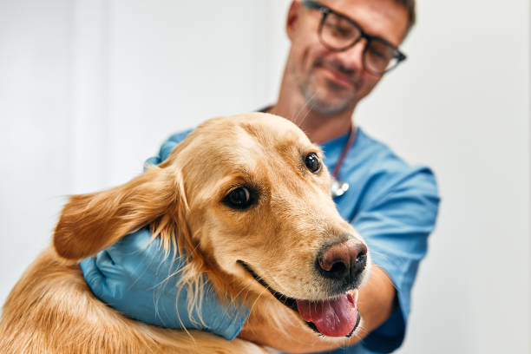
Petdoc
Smart Veterinary
System
AI-Powered Disease Detection
CSE 299 Progress Report
Section 04 | Group 05
Group 05 | Rishat Bin Sultan, Fariha Islam, MD Tamim Hasan
March 2026

Slide 2
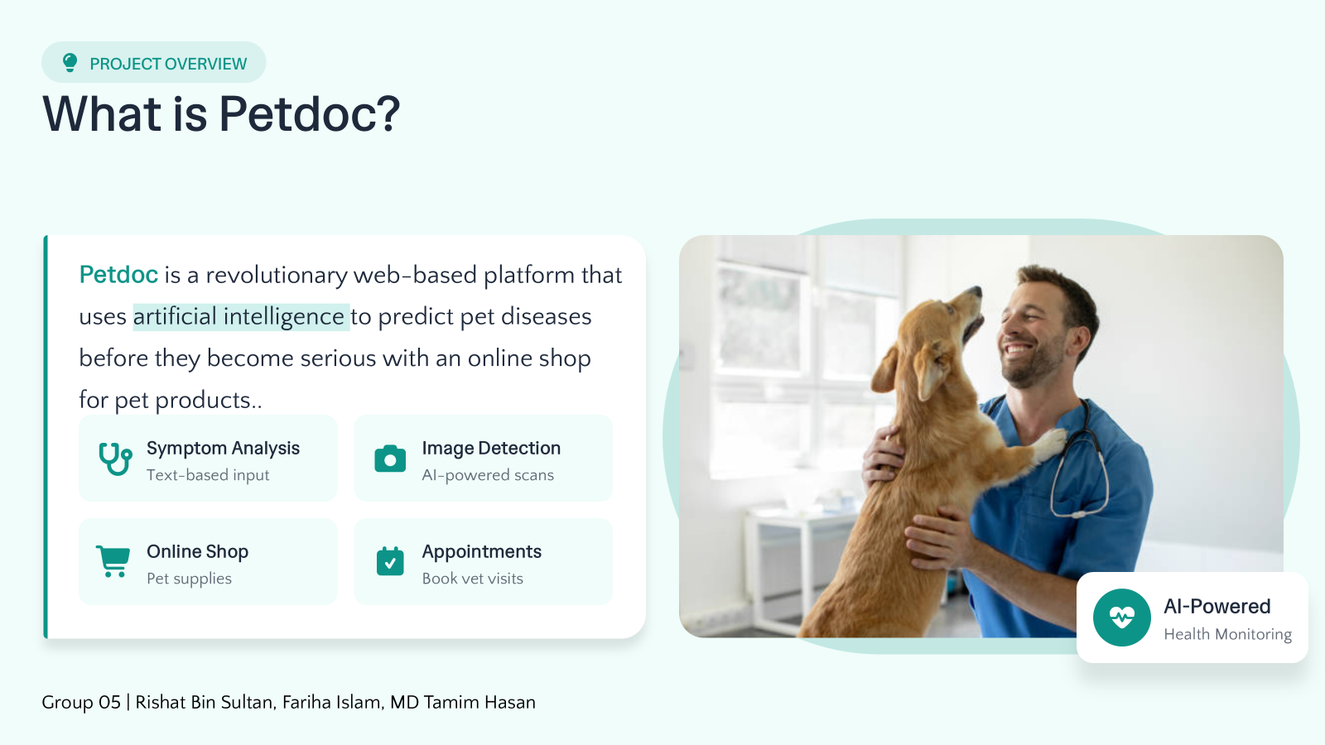

Slide 3
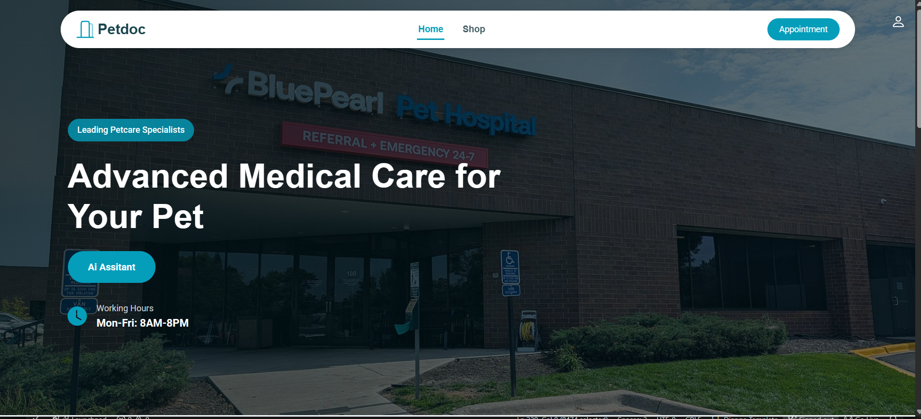
LIVE DEMO
Homepage
Clean, professional, and user-friendly design
Modern Navigation
Intuitive menu with Home, Shop, and Appointment access
AI Assistant Button
One-click access to disease detection feature
Appointment CTA
Prominent button for booking vet consultations
Tagline
Group 05 | Rishat Bin Sultan, Fariha Islam, MD Tamim Hasan
"Advanced Medical Care for Your Pet"

Slide 4
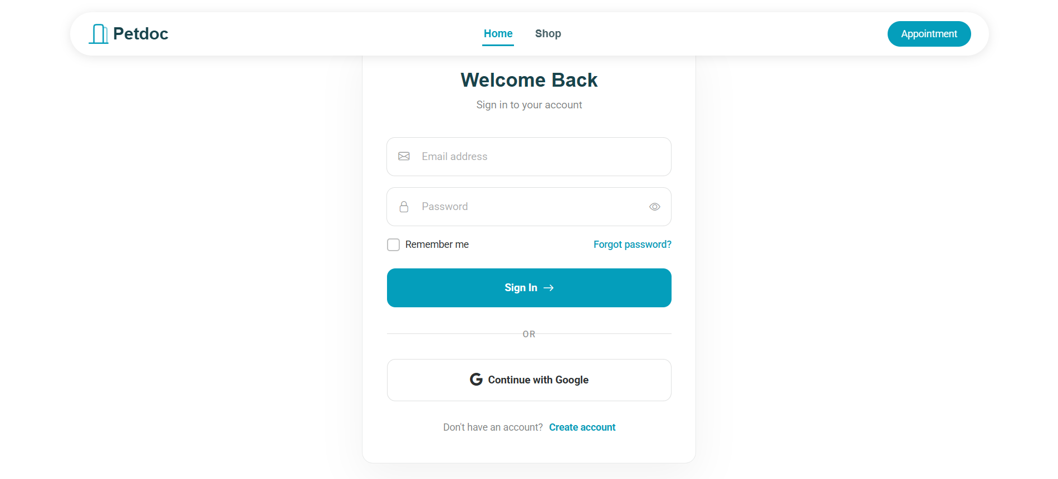
LIVE DEMO
Login Page
Secure and seamless authentication
Email Login
Simple email and password fields with validation
Google Sign-In
One-click authentication with Google account
Password Recovery
"Forgot password?" link for account recovery
Features
Group 05 | Rishat Bin Sultan, Fariha Islam, MD Tamim Hasan
6 / 12
Remember Me
Session Management
Secure Logout

Slide 5
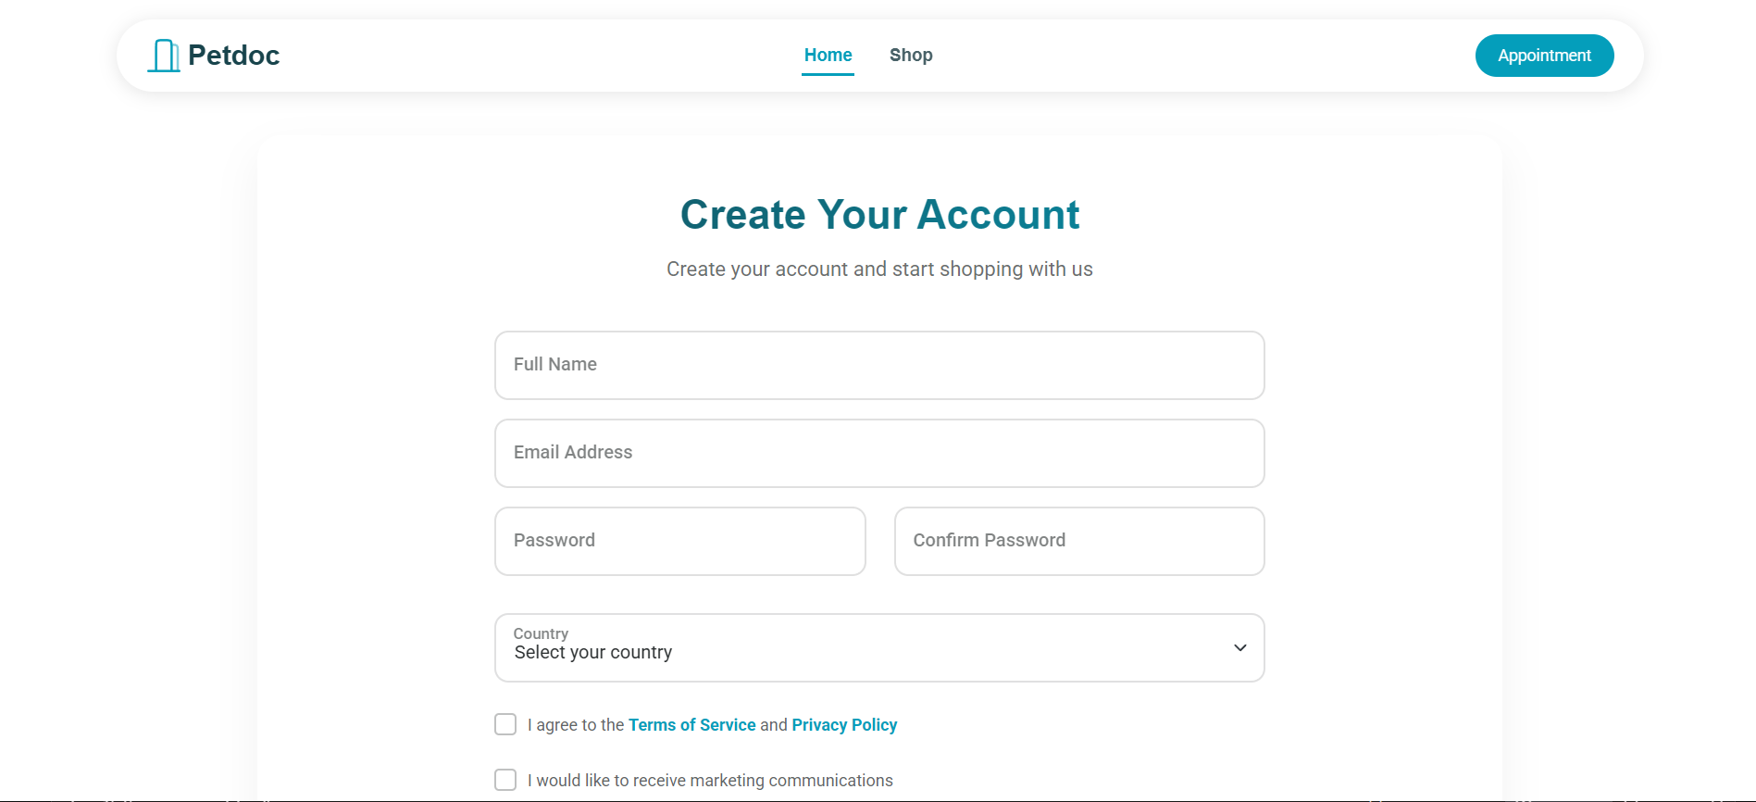
LIVE DEMO
Registration Page
Comprehensive user onboarding
Full Name
Complete user identification
Email Address
Valid email with verification
Secure Password
Password + confirmation fields
Country Selection
Dropdown for location
Compliance
Terms of Service agreement
Privacy Policy acceptance
Group 05 | Rishat Bin Sultan, Fariha Islam, MD Tamim Hasan
7 / 12
Marketing opt-in option

Slide 6
PROGRESS
What We Built
Milestones achieved in this phase
Homepage Layout
Rishat
Team Contributions
Complete HTML/CSS design with responsive structure
✓ Complete
RS
Rishat Bin Sultan
Registration Page
ID: 2312559042
Tamim
Homepage design
Form validation and user input handling
✓ Complete
Session management
Login System
Fariha
FI
Fariha Islam
ID: 2311101642
Authentication backend with Django views
✓ Complete
Backend authentication
Database models
Database Models
Fariha
User authentication models and schema
✓ Complete
TH
MD Tamim Hasan
ID: 2232239642
Registration page
Django views
Group 05 | Rishat Bin Sultan, Fariha Islam, MD Tamim Hasan
9 / 12

